Slide 1
Windows Powershell in Action

Slide 2
Agenda for Powershell (Level:200)
Powershell Introduction
Variable & Object
Powershell Operator
Loop and Flow Control
Function and Debug
Powershell in Action

Slide 3
What is Powershell??
Windows Powershell is a command-line shell and scripting environment that brings the power of the .NET Framework to command-line users and script writers.
It introduces a number of powerful new concepts that enables you to extend the knowledge you have gained and the scripts you have created within the Windows Command Prompt and Windows Script Host environments.

Slide 4
New Feature in Powershell
Discoverability
Consistency
Interactive and Scripting Environments
Object Orientation
Easy Transition to Scripting

Slide 5
Powershell fundamental
Revolutionary interactive shell and scripting language
  Based on .NET
  New set of built-in tools (~130)
  New language to take advantage of .NET
    An “object-based” pipeline view
  Can continue to use current tools
  Can continue to use current instrumentation (COM, ADSI, WMI, ADO, XML, Text, …)

Slide 6
Frequently Asked Questions
Do I need to learn .NET before I can use Powershell?
  No - you can continue to use existing tools
Do I need to rewrite all my existing tools?
  No - existing tools will run just fine
Do I need to learn the new language?
  No - You can easily run existing commands without modification
  Many Unix and DOS commands work… try them…

Slide 7
To begin working…
Commands are built with logic
  Verb-noun
Pipeline “ | ”
Some good starters
  Get-Help
  Get-Command | more
  Get-Command | sort-object noun | format-table -group noun
  Get-Alias | more
  Get-Help stop-service -detailed | more

Slide 8
Learning and Documentation
Online help is full of examples
Many books and documentation are available already
  Microsoft Press – Microsoft Windows PowerShell Step By Step
  Manning – Windows PowerShell in Action
  Sams – Windows PowerShell Unleashed
  Sapien Press – Microsoft Windows PowerShell
  TechNet - Scripting with Windows PowerShell

Slide 9
PowerShell Releases
Get v1.0 from the Download Center for:
  Windows XP SP2
  Windows Server 2003 SP2
  Windows Vista
  Windows Server 2008 RC0 (no need to d/l, available as a feature)
Downloading and Installing Windows PowerShell Version 1.0
http://www.microsoft.com/technet/scriptcenter/topics/msh/download.mspx
Version 2.0 is CTP
http://www.microsoft.com/technet/scriptcenter/topics/winpsh/pshell2.mspx

Slide 10
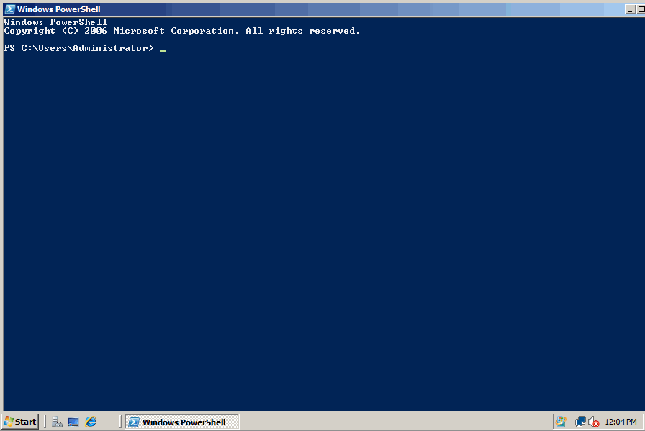
PowerShell

Slide 11
Installation Requirements
Before you install Windows PowerShell, be sure that your system has the software programs that Windows PowerShell requires. Windows PowerShell requires the following programs:
  • Windows XP Service Pack 2, Windows 2003 Service Pack 1, or later versions of Windows
  • Microsoft .NET Framework 2.0
If any version of Windows PowerShell is already installed on the computer, use Add or Remove Programs in Control Panel to uninstall it before installing a new version.

Slide 12

Session 1 Ending
Demo and Q&A

Slide 13
Variable & Object
Variable Name
Variable Type and Type Adaptation
All Variables are Object
Array
Environmental Variables

Slide 14
Variable Name
You can use virtually any variable name you choose, names are not case sensitive.
But, there are illegal characters such as; ! @ # % & , . and spaces. PowerShell will throw an error if you use an illegal character.
$Microsoft $MicroSoft $microsoft are The Same!
${My English Name is #merlin@} is OK!

Slide 15
Variable Type
Powershell variable type is base on .NET Framework.
Common variable is as below:
  [adsi], [array], [bool], [byte], [char]
  [datetime], [decimal], [double]
  [int] or [int32], [long]
  [single], [scriptblock], [string]
  [WMI], [WMIclass], [xml]

Slide 16
Declaring Variables and Type Adaptation
$a=333
$b=“66”
$c=SS
$a.GetType()
$b.GetType().Name
$a+$b ; $b+$a ??
$b+$c ; $c+$b ??
$a+$c ; $c+$a ??

Slide 17
All Variables are Object
[int]$Age=22
$Age.GetType()
$Age GetType().Name
$Age | Get-Member
$Title=“manager”
$Title.length
$Title.CompareTo()

Slide 18
Array
$RainbowColor = "red", "orange", "yellow", "green", "blue", "indigo", "violet"
$a = 3, "apple", 3.1415926, “cat“, 23
[int[]]$b = 51, 29, 88, 27,50
$b.SetValue(19, 3)
$b[-1]=888
$PeopleTable = @{“Merlin Lin" = “3725-3888"; “Linda Chen" = “0800-000-213"…}

Slide 19
Environmental Variables
Get-ChildItem Env:
Creating – and Modifying -- Environment Variables
  $env:testv = "This is a test environment variable.“
  [Environment]::SetEnvironmentVariable("testv", "VVVV", “User")
  [Environment]::GetEnvironmentVariable(“testv","User")
  Remove-Item Env:\testv
  [Environment]::SetEnvironmentVariable(“testv” ,$null,"User")

Slide 20
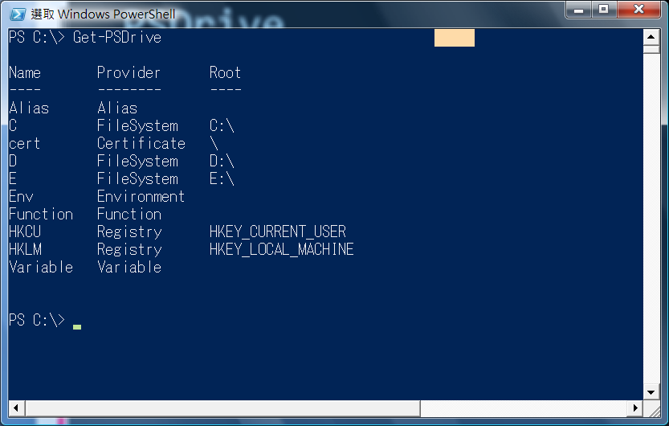
PSDrive

Slide 21
PSDrive Operation
Get-PSDrive
mount -Name Seting -psProvider FileSystem -Root "C:\Documents and Settings”
mount -Name MS -PSProvider Registry -Root HKLM\Software\Microsoft
rdr -Name MS
Set-Location
Get-Location

Slide 22

Session 2 Ending
Demo, Q&A and Break

Slide 23
Powershell Operator
Arithmetic Binary Operators
  +, -, *, \, %, ++, --
Assignment Operators
  =, +=, -=, *=, /=, %=
Logical Operators
  !, -not, -and, -or
String Operators
  +, *, -f, -replace, -match, -like
Comparison Operators
  -eq, -ne, -gt, –ge, -lt, –le

Slide 24
Arithmetic Binary Operators
123+789 ; 222-876
34.5*44.2 ; 13/7
123%5
$var++ ; ++$var ➔ $var = $var + 1
$var-- ; --$var ➔ $var = $var – 1

Slide 25
Assignment Operators
$var=3
$var+=3 ; $var-=3
$var*=3 ;$var/=3 ; $var%=3
$var = 0x10 ➔ echo $var ➔ 16
$var = 7.56e3 ➔ echo $var ➔ 7560
$var=7MB ➔ echo $var ➔ 7340043 (bytes)

Slide 26
Logical Operators
(7 -eq 7) -and (2 -eq 5)
(7 -eq 7) -or (2 -eq 5)
(9 -eq 9) -xor (4 -eq 4) ; (9 -eq 9) -xor (4 -eq 7)
(3 -eq 3) -and !(2 -eq 2)
(3 -eq 3) -and -not (2 -eq 9)

Slide 27
String Operators
-like ; -clike ; -ilike | To be like as
-notlike ; -cnotlike ;-inotlike | To not be like as
-match ; -cmatch ;-imatch | Match
-notmatch ; -cnotmatch ; -inotmatch | Not match
-contains ; -ccontains ; -icontains | Include
-notcontains; -cnotcontains ; -inotcontains | Not include

Slide 28
Comparison Operators
-le ; -cle ; -ile ➔ <=
-eq; -ceq; -ieq ➔ =
-ne; -cne; -ine ➔ !=
-gt; -cgt; -igt ➔ >
-ge; -cge; -ige ➔ >=
-lt; -clt; -ilt ➔ <
-le; -cle; ile ➔ <=

Slide 29

Session 3 Ending
Demo and Q&A

Slide 30
Loop and Flow Control
If…. elseif… else…
Switch…… default
ForEach（Foreach-Object）
For
While
Do….. While
Do…..Until
Break & Continue

Slide 31
If…. elseif… else…
If (< statement 1>)
{ < code 1> }
Elseif (< statement 2>)
{ < code 2> … }
Else { <code n> }

Slide 32
Switch…… default
Switch [-regex|-wildcard|-exact][-casesensitive] -file <filename> (< variable >)
{
< Pattern 1> { code 1 }
< Pattern 2> { code 2 }
< Pattern 3> { code 3 } …
Default { code n }
}

Slide 33
ForEach（Foreach-Object）
ForEach
($<item or object> in $<Collection object>)
{ <code> }
dir | ForEach -process { $_.length / 1024}

Slide 34
For
For (<initial>; < statement >; < count>) {
<code>
}

Slide 35
While, do while, do until
While (< statement >) {
<code> }
Do { < code >
} While (< statement >)
Do {<code>
} Until (<statement>)
ps. “Until” can wait something happen!!

Slide 36
Break; Continue
For ($i = 1; $i -le 10; $i++) {
Write-Host $i
If ($i -eq 5) { Write-Host "BREAK!!“
Break } }
ForEach ($i in 1..10) {
If ($i % 2) {
Continue }
$i }

Slide 37

Session 4 Ending
Demo, Q&A and Break

Slide 38
Function and Debug
Script Block
Function
Function Arguments
Function Return Values
Variable Scope
Debug

Slide 39
Script Block
PS > $a = { $x = 2 , $y = 3 , $x * $y }
  PS > &$a
  PS > 6
PS > $lsName = { ForEach($item in $input)
{ $item.Name }
}
  PS > dir | &$lsName

Slide 40
Function
PS > Function MySimpleFun {
Write-Host “This is a function“
}
PS > MySimpleFun
This is a function

Slide 41
Function Arguments
PS > Function Show-Str {
Write-Host $args[0]
}
PS > Show-Str “Hello , First Arg!!”
Hello, First Arg!!

Slide 42
Function Return Values
PS > Function AandB([int]$x=10, [int]$y=90) {
>> $x + $y
>> $x - $y
>> $x * $y
>> }
>>
PS > AandB 8 2
10
6
16
PS > $rst = AandB 8 2
PS > $rst.Length
3

Slide 43
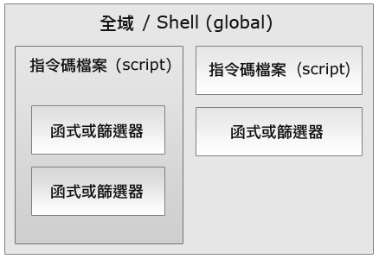
Variable Scope

Slide 44
Debug
Write-Verbose ; Write-Debug
請檢查 PowerShell Script 是否有可讀及可執行權限
請注意PowerShell 不是完全自由語法就像 if [ “$#” -ne 1 ] 就不能寫成 if [“$#” -ne 1] 也不能寫成 if[ “$#” -ne 1 ] . 假如執行時有錯誤訊息, 要詳加檢查程式的語法結構. 該空格的地方要有空格.
要了解 $variable 才是變數的內容, 你很有可能把 variable 當成變數的內容.
你可能拼錯字了, 這是很常見的
有些情況下, 變數中的內容並不是你預期的 , 以致造成 錯誤. 此時可在程式中可疑的地方適時的加上一些 偵錯點 , 把這些變數內容顯示出來看看
使用Powershell debugger, 如 PowerGUI
最後 , 邏輯上的錯誤是很難找到的 , 你可能也要注意

Slide 45
Powershell in Action
ActiveDirectoryDemos
Get-DomainInfo
Get-HotFixes
Get-MachinesMissingHotfix
Get-SoftwareFeatures

